Slide 1
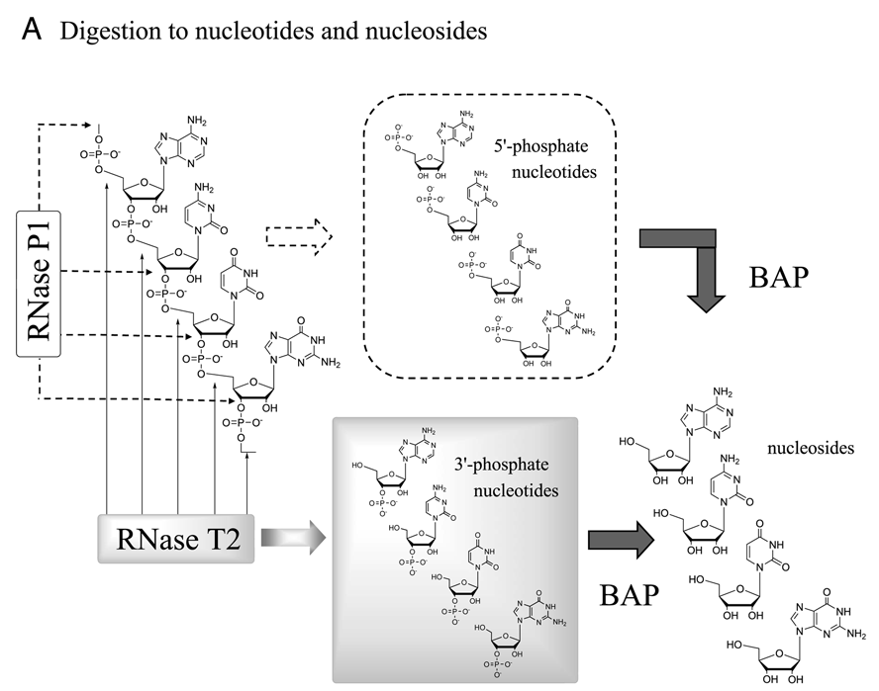
Modified after pmid 20224293

